Slide 1
Functions Part 2
Section 2
Chapter 4
© 2016 Pearson Education, Ltd. All rights reserved.

Slide 2
Functions Calling Other Functions
Function can call another function
When the called function terminates
  Control returns to the place in calling function just after where function call occurred.
Example 1 : Function firstPart calls the function secondPart.
© 2016 Pearson Education, Ltd. All rights reserved.

Slide 3
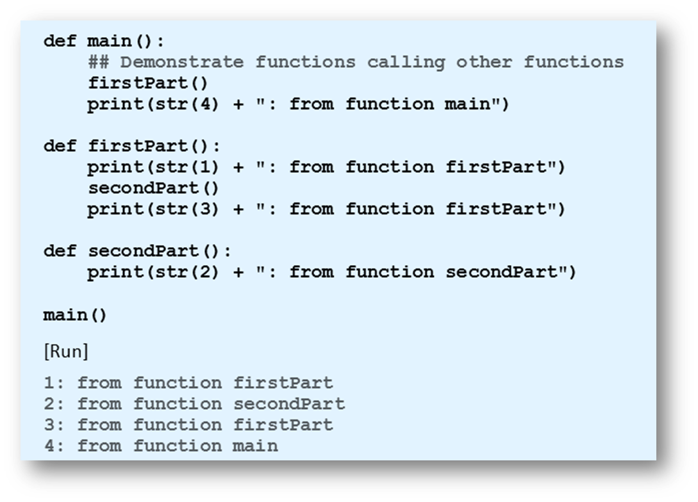
Functions Calling Other Functions
Example 1
© 2016 Pearson Education, Ltd. All rights reserved.

Slide 4
Functions Returning
Multiple Values
Functions can return any type of object
  Function can return a tuple.
Example 2: balanceAndInterest function returns a tuple
  Giving values associated with deposit into savings account.
© 2016 Pearson Education, Ltd. All rights reserved.

Slide 5
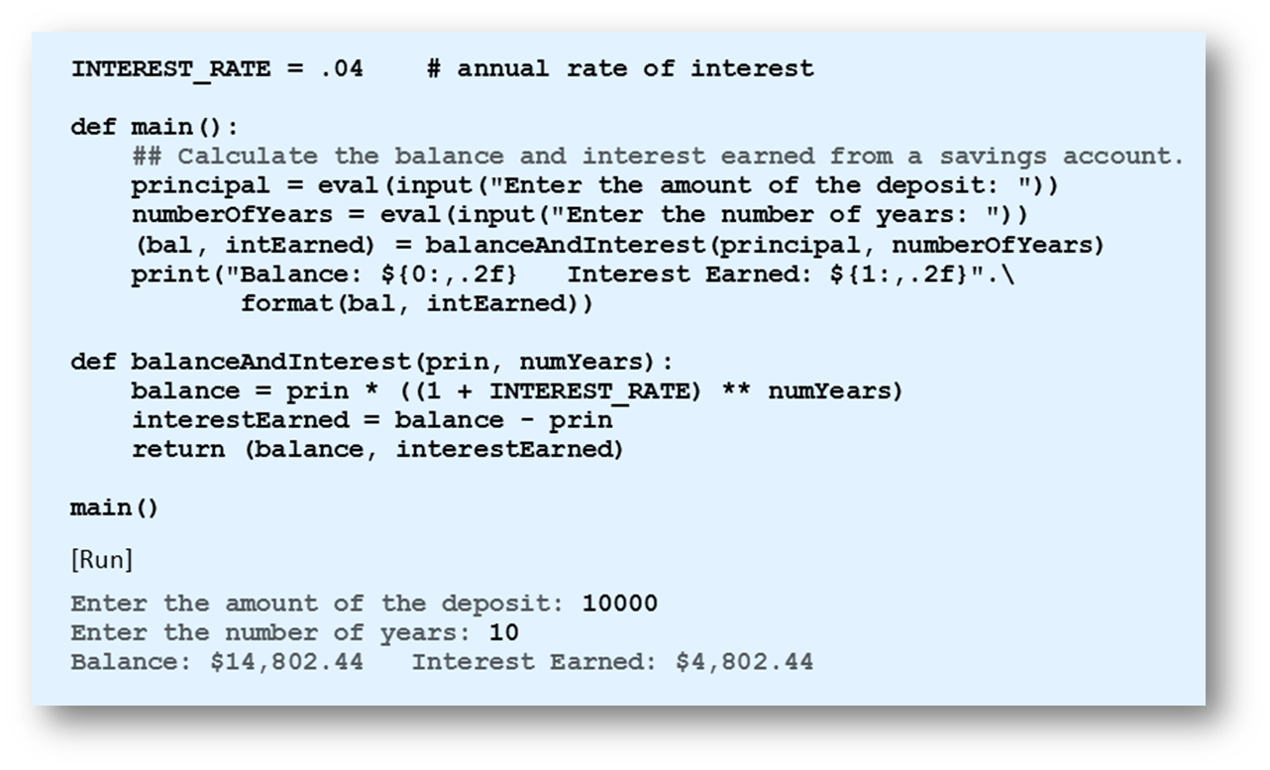
Functions Returning Multiple Values
Example 2
© 2016 Pearson Education, Ltd. All rights reserved.

Slide 6
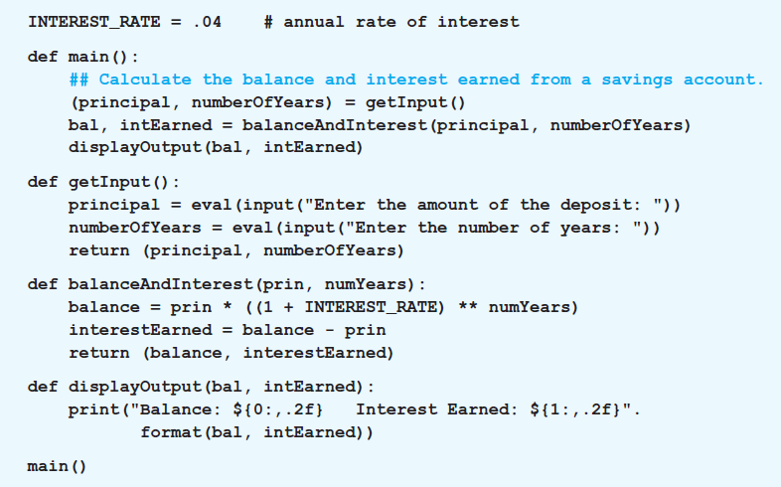
Functions Returning Multiple Values
Example 3: Variation of Example 2 has the input, processing, and output performed individually by three functions.
© 2016 Pearson Education, Ltd. All rights reserved.

Slide 7


List Comprehension
Simpler way to apply a certain function to each item of a list
  Use list comprehension
The for clause in a list comprehension can optionally be followed by an if clause.
© 2016 Pearson Education, Ltd. All rights reserved.

Slide 8

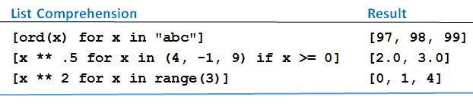
List Comprehension
Table 4.3 Examples of list comprehension.
© 2016 Pearson Education, Ltd. All rights reserved.

Slide 9
Default Values
Parameters of a function can have default values
  Assigned to them when no values are passed to them
Format for definition using default values
© 2016 Pearson Education, Ltd. All rights reserved.

Slide 10

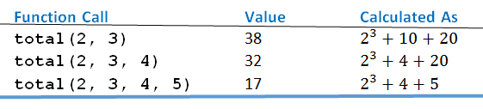
Default Values
Table 4.4 Three function calls
© 2016 Pearson Education, Ltd. All rights reserved.

Slide 11
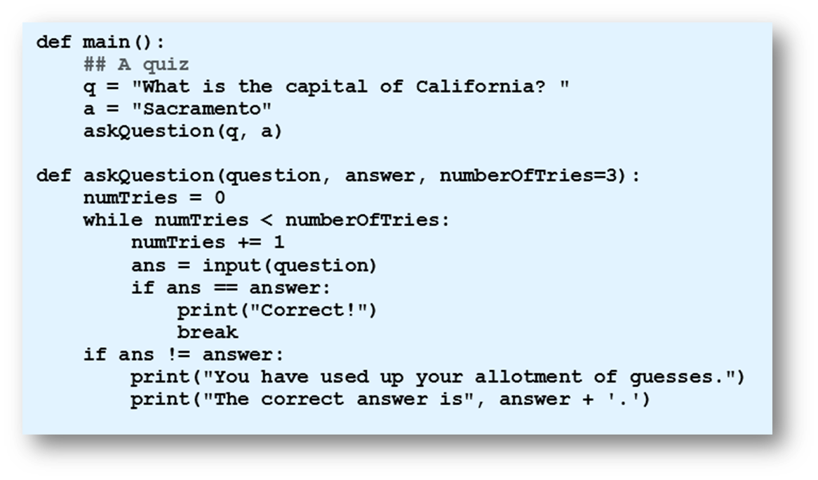
Default Values
Example 4: Program gives user three tries to answer question
© 2016 Pearson Education, Ltd. All rights reserved.

Slide 12


Passing by Parameter Name
Arguments can be passed to functions by using names of the corresponding parameters
  Instead of relying on position
Given
  Could use
© 2016 Pearson Education, Ltd. All rights reserved.

Slide 13
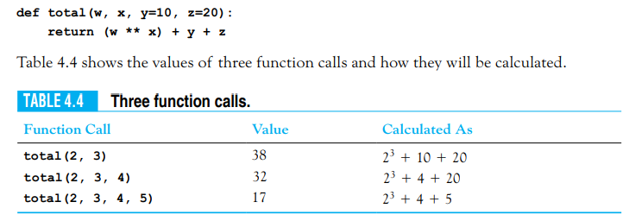
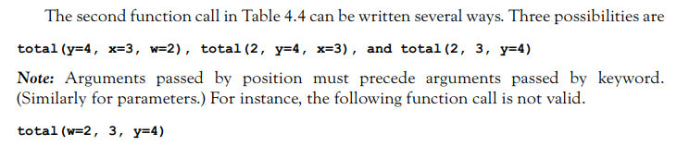
Passing by Parameter Name
© 2016 Pearson Education, Ltd. All rights reserved.

Slide 14
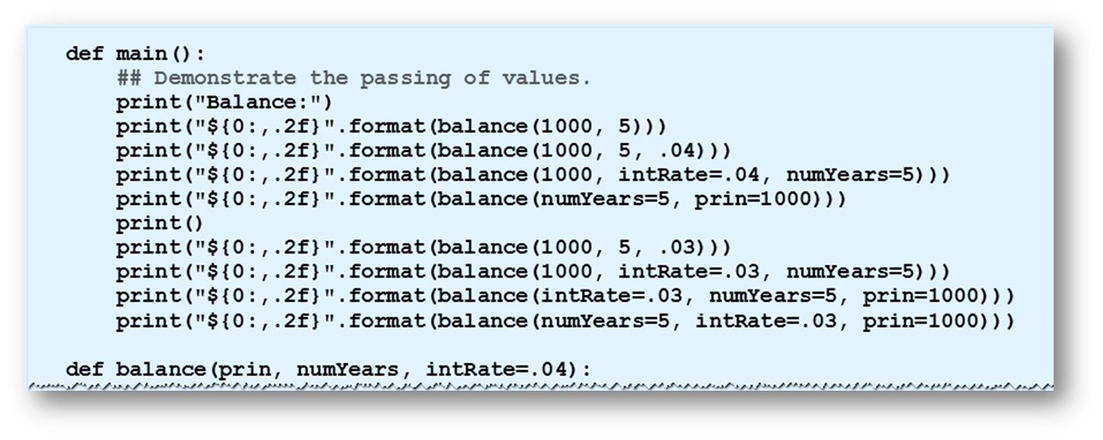
Passing by Parameter Name
Example 5: Several ways to pass values
© 2016 Pearson Education, Ltd. All rights reserved.

Slide 15
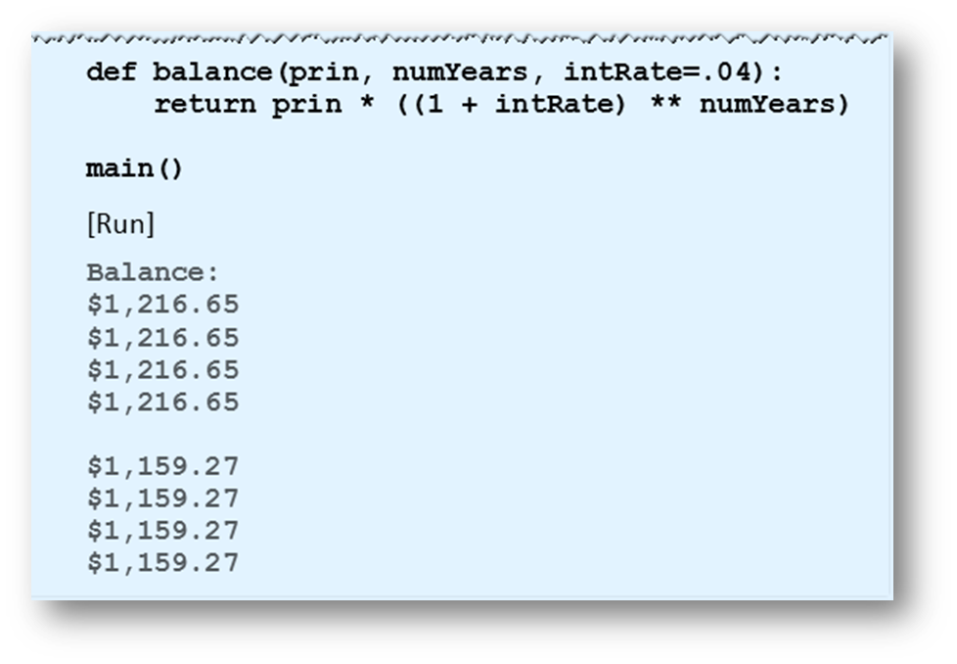
Passing by Parameter Name
Example 5: Several ways to pass values
© 2016 Pearson Education, Ltd. All rights reserved.

Slide 16
Custom Sorting
Functions can be used to order the items by any criteria we choose
With a list of strings, we can sort them by
  Length
  Last characters
  Number of vowels
  … by many other properties
© 2016 Pearson Education, Ltd. All rights reserved.

Slide 17
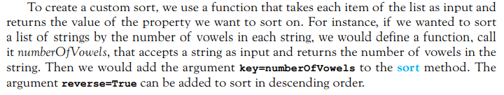
Custom Sorting
© 2016 Pearson Education, Ltd. All rights reserved.

Slide 18
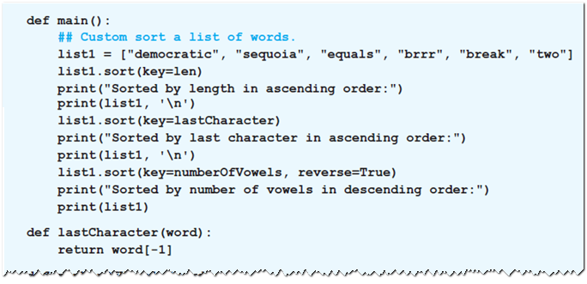
Custom Sorting
Example 6: Program sorts list of words using each of three properties mentioned above
© 2016 Pearson Education, Ltd. All rights reserved.

Slide 19
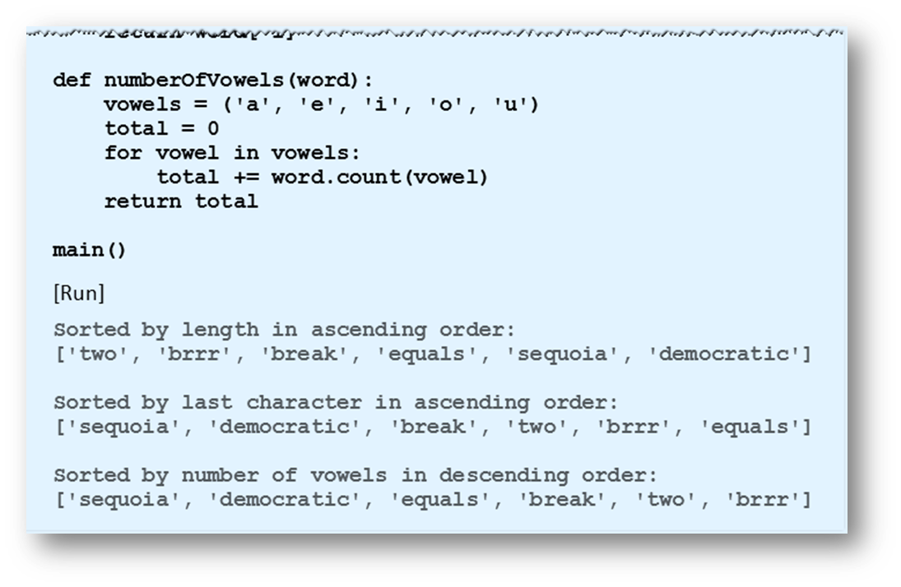
Custom Sorting
Example 6: Program sorts list of words using each of three properties mentioned above
© 2016 Pearson Education, Ltd. All rights reserved.

Slide 20
Lambda Expressions
One-line mini-functions
  Can be used where a simple function is required.
  Compute a single expression
  Cannot be used as a replacement for complex functions
Format
  Where expression is the value to be returned
© 2016 Pearson Education, Ltd. All rights reserved.

Slide 21
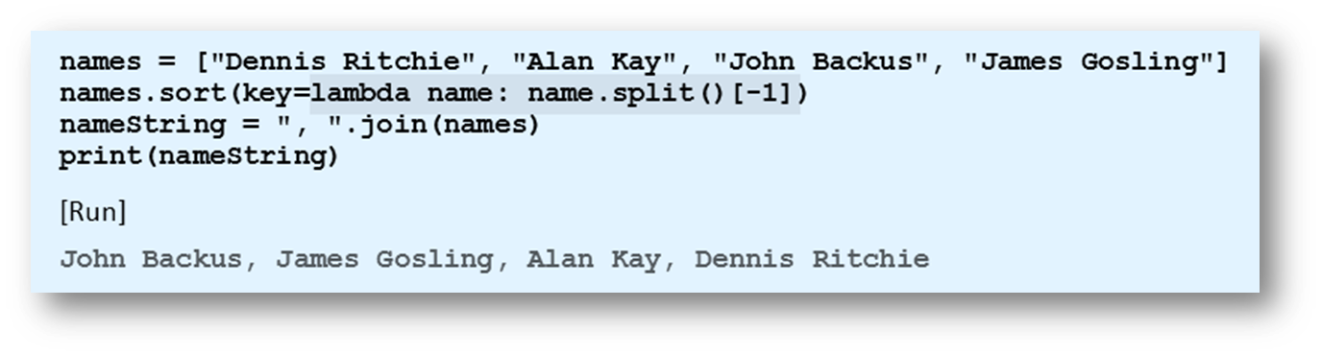
Lambda Expressions
Example 7: Function sorts names by their surnames
  Lambda function highlighted
© 2016 Pearson Education, Ltd. All rights reserved.

Slide 22

The sorted Function
Contrast with sort function
  sort function alters order of items in a list
  sorted function returns a new ordered list
  Both can make use of the optional arguments key and reverse.
  sorted function also can be used with lists, strings, and tuples
© 2016 Pearson Education, Ltd. All rights reserved.

Slide 23
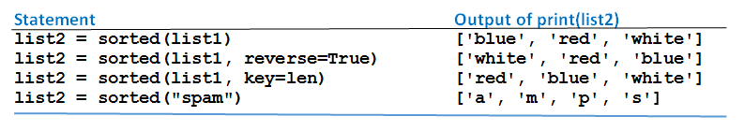
The sorted Function
Table 4.5 Values produced by
sorted function (list1 = ["white", "blue", "red"])
© 2016 Pearson Education, Ltd. All rights reserved.

Slide 24
End
Section 2
Chapter 4
© 2016 Pearson Education, Ltd. All rights reserved.

